Slide 1

Egg Hunt Project
Use your CodeX to look for hidden Easter Eggs

Slide 2
Easter Egg Hunt
What is an Easter egg?
You probably think of decorated eggs that are hidden by a bunny.
Sometimes the eggs even have treats in them!
People go on an egg hunt to find them.

Slide 3
Easter Egg Hunt
In Computer Science, an easter egg has a slightly different meaning.
A digital easter egg is a hidden, unexpected image, feature or message.
It can be hidden in an image, discovered with a keystroke, or revealed after a sequence of actions.
Sometimes people go on a hunt to find them.

Slide 4
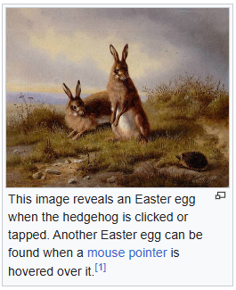
Easter Egg Hunt
Try finding some yourself.
Go to Wikipedia and type “Easter egg (media)”
Follow the instructions under the rabbit image.

Slide 5
Easter Egg Hunt
Google has several Easter eggs.
In the Chrome browser, open a new tab and do a Google search.
In the search bar, type: do a barrel roll
Then press <enter>

Slide 6
Easter Egg Hunt
Here is another one.
In the Google search bar, type: 67
Then press <enter>

Slide 7

Easter Egg Hunt
Here is one more.
In the Google search bar, type: cha cha slide
Then press <enter>
Click on the icon in the upper right corner (several times)

Slide 8
Easter Egg Hunt
Digital easter eggs can be found:
In the Google search bar
Embedded in images or text
In video games
In some YouTube video sites
In Facebook language settings
Sometimes in a software program itself

Slide 9
Easter Egg Hunt
For this project you will:
Create your own pixel images.
Share them with your classmates.
Create a custom module of pixel images that you can import.
Simulate digital easter eggs by randomly hiding surprise pixel images in the program.
Go on a “hunt” to find them.

Slide 10
Egg Hunt Project
Draw your own pixel art easter eggs

Slide 11
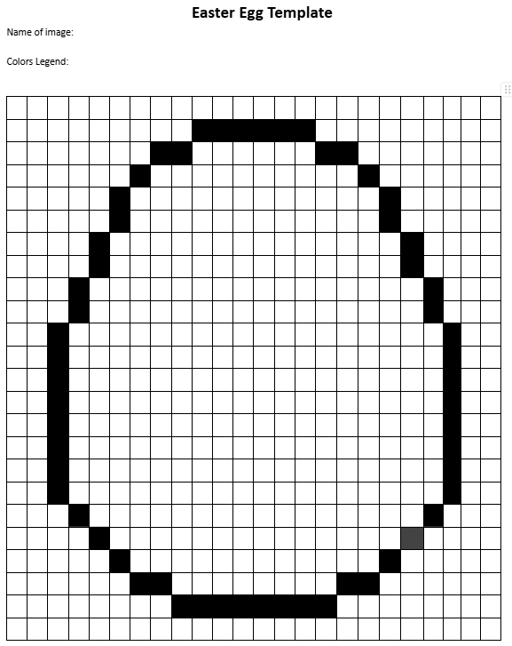
Part 1: Get started
Get an 24x24 Easter egg grid from your teacher.
Design your egg.
Each egg needs a unique name.
Follow the grid to keep all the Easter eggs the same size and dimensions.
Remember: Each square pixel can be only one color!

Slide 12

Part 2: Code your egg
Go to make.firialabs.com
Log in (use your account)
Go to the Sandbox
Icon on the right side bar, near the bottom

Slide 13

Part 2: Code your egg
In the text editor:
Start a new file: eggs.py
The file name MUST end with .py
Import the codex and ascii_art libraries.

Slide 14
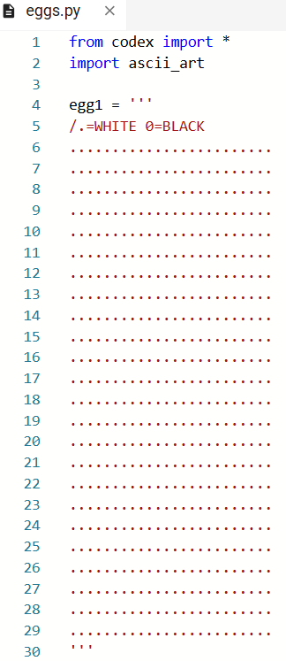
Part 2: Code your egg
Code your pixel image.
Give it a name.
Use three quote marks.
Start the color legend.
Create 24 rows of 24 .
End with three quote marks.

Slide 15
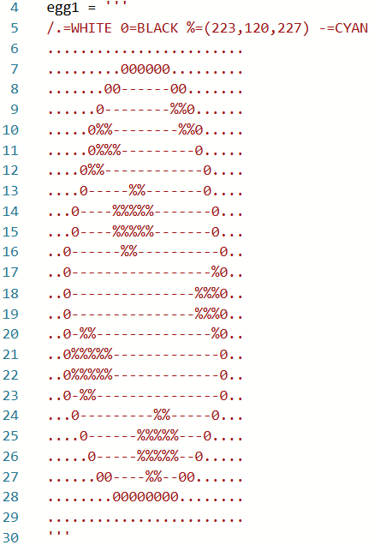
Part 2: Code your egg
Follow the image on the paper grid to code your egg.
Add symbols with colors as needed to your color legend.
The symbols can be numbers, letters or characters.
Be careful with the spacing and no-spacing when adding to the legend.

Slide 16

Part 2: Code your egg
Add code to display your decorated egg.
Use the name of YOUR image in the code.
Make sure the egg is displayed without any errors.

Slide 17
Part 2: Code your egg
When your image is complete and displays on the screen:
Delete the two lines of code.
Submit your image to your teacher. It will be compiled into one file with all the other images from your classmates.

Slide 18

Part 3: Images Custom Module
Your teacher compiled all the images into a text file.
You now have a custom module that you can import to any CodeX program and then use the pixel art images.
In CodeSpace, open your eggs.py file.
Open the text file of compiled images.
Copy the code from the text file and paste it into the eggs.py file.
It should have all the egg images from your classmates and end with this code:

Slide 19

Part 3: Images Custom Module
Run the code.
Nothing will appear on the CodeX.
Check the console panel. You should see this message:
The image file is now loaded on the CodeX and can be imported, just like other libraries!

Slide 20
Egg Hunt Project
Code the egg hunt program

Slide 21
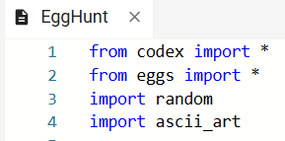
Part 1: Create lists
In the text editor, start a new file.
Call the file EggHunt
Import the codex, eggs, ascii_art and random libraries.

Slide 22
Part 1: Create lists
Your custom module has all the images created for the project.
Some images are the decorated eggs.
Some images are the “surprise” images that will be the hidden easter eggs.
Even though they are all in one file, the images have individual names and can be used separately.

Slide 23
Part 1: Create lists
You will need some lists to work with during this program.
Define three lists:
A list for all the decorated eggs: egg_list
A list for all the hidden easter eggs: easter_eggs
An empty list that will contain the eggs that hide images: hides_an_egg
Use the names of all the eggs.py images in the first or second list.

Slide 24
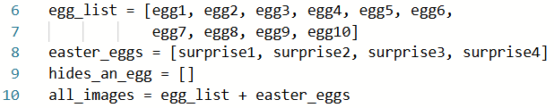
Part 1: Create lists
Your lists may look like this:
But remember: use the names of your images!

Slide 25
Part 2: Display a random egg
Start the main program.
Write code for pressing BTN-A.
If the button is pressed:
Get a random item from the egg_list.
Display it on the screen.
Run the program and fix any bugs.

Slide 26
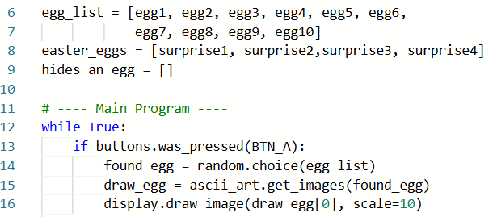
Part 2: Display a random egg

Slide 27
Part 3: Hide the easter eggs
How many “surprise” images do you have?
You want to hide each one behind a decorated egg from the egg_list.
Fill the hides_an_egg list with random decorated eggs, one egg for each “surprise” image.
Use a for loop. The range is the length of the easter_eggs list.
Add eggs to the hides_an_egg list using append.

Slide 28
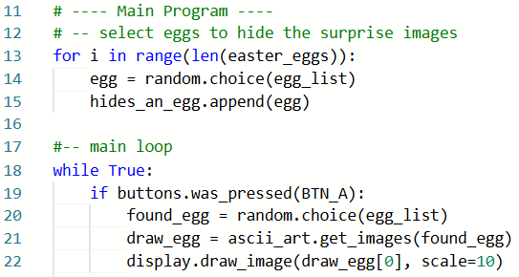
Part 3: Hide the easter eggs
Note: a decorated egg can hide more than one “surprise” image!

Slide 29
Part 4: Find the easter eggs
Use BTN-B to look for the easter eggs.
You can use some handy list functions for this part.
in
This function checks if a variable is an item in the list. if found_egg in hides_an_egg:
remove
This function removes an item from a list. hides_an_egg.remove(found_egg)

Slide 30
Part 4: Find the easter eggs
If BTN-B is pressed:
See if the current found_egg is in the list hides_an_egg.
If it is in the list, an easter egg is hidden behind it.
Select a random image reveal from the easter_eggs list.
Display the image to reveal the hidden easter egg.
Remove reveal from the easter_eggs list.
Remove the found_egg from the hides_an_egg list.

Slide 31
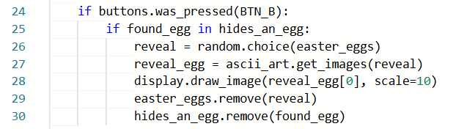
Part 4: Find the easter eggs
Your code should look similar to this:

Slide 32
Part 4: Find the easter eggs
Run the code and fix any bugs.
After each decorated egg is displayed, press BTN-B to see if an easter egg is hidden behind it.
The same egg may be randomly selected back to back.
If the found egg is in the list, an surprise image will appear.
If the found egg is not in the list, nothing will happen.

Slide 33
Part 5: All easter eggs found
This program will continue until you stop it, even after all the eggs have been found.
You can display a message when all easter eggs have been found.
Add an if statement to the BTN-B press.
If the hides_an_egg list is empty, display a message.
Change the current if statement to an elif.

Slide 34
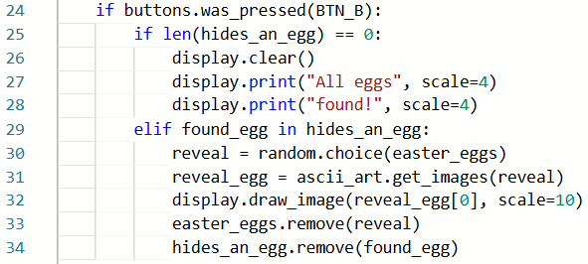
Part 5: All easter eggs found
Your code may look like this:

Slide 35
Egg Hunt
Nice job!
With the last part added, you can keep displaying eggs without pressing BTN-B.
Or you can break the loop and end the program after all the hidden easter eggs have been found.

Slide 36
Egg Hunt Project
Extensions
Add even more elements to your program.

Slide 37
Extensions #1
Add an introduction, so when a person runs the program, they know what buttons to press.
Add a counter and display how many button presses it took to find all the easter eggs.
As an extra challenge, don’t count any button presses after all the easter eggs were found.

Slide 38
Extensions #2
Use a button press to restart the game.
Get a new hides_an_egg list.
Reset the counter, if you have one.
Add the option to the intro, if you have one.
Display the intro again so it is clear the program started over.
Use another button press to end the program.

Slide 39
Extensions #3
Modify the program so the same egg cannot be “found” or displayed two times in a row. Each time BTN-A is pressed, a new egg must show.
Modify the algorithm for filling the hides_an_egg list so that no egg is duplicated.
This option can decrease the amount of tries needed if you remember which eggs hide a surprise.
Hint: you can use not in, which is the opposite of in

Slide 40
Extensions #4
Try something else with the images.
Create a quilt pattern on the display screen of random images.
If you don’t change the scale, 10 images will fit across the screen.
You can combine both lists of images by “adding” them together: all_images = egg_list + easter_eggs

Slide 41
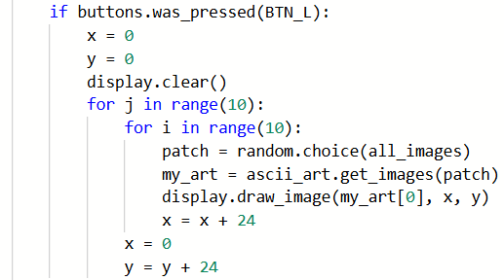
Extensions #4
Sample code:

Slide 42
Extensions #4
Alter the algorithm so that all the decorated eggs are printed, and then a random surprise image.
How will the algorithm need to change?

Slide 43
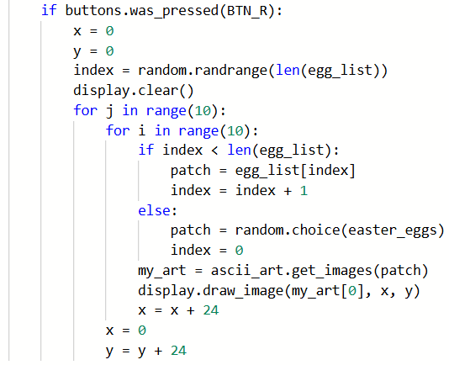
Extensions #4
Sample code:

